Slide 1

HOUSEHOLD WASTE MANAGEMENT SYSTEM

Slide 2
TEAM MEMBERS
S R SUDHARSON
THAWFILL FATHEEN S
THIRUMURUGAN V
VASANTH S

Slide 3
Objective
Waste Segregation
Efficient Waste Collection
Recycling and Resource Recovery
Environmental Sustainability
Integration with Smart Technologies

Slide 4

BRAIN - STROMING

Slide 5
Keywords
Smart Sorting
AI Solution
Composting
Collection
Dispose
Community
Life cycle
Awareness
Manage Waste
Data Analysis
Waste Audit
Cost effective
Recycle
Cleanliness
Education
Scalability

Slide 6
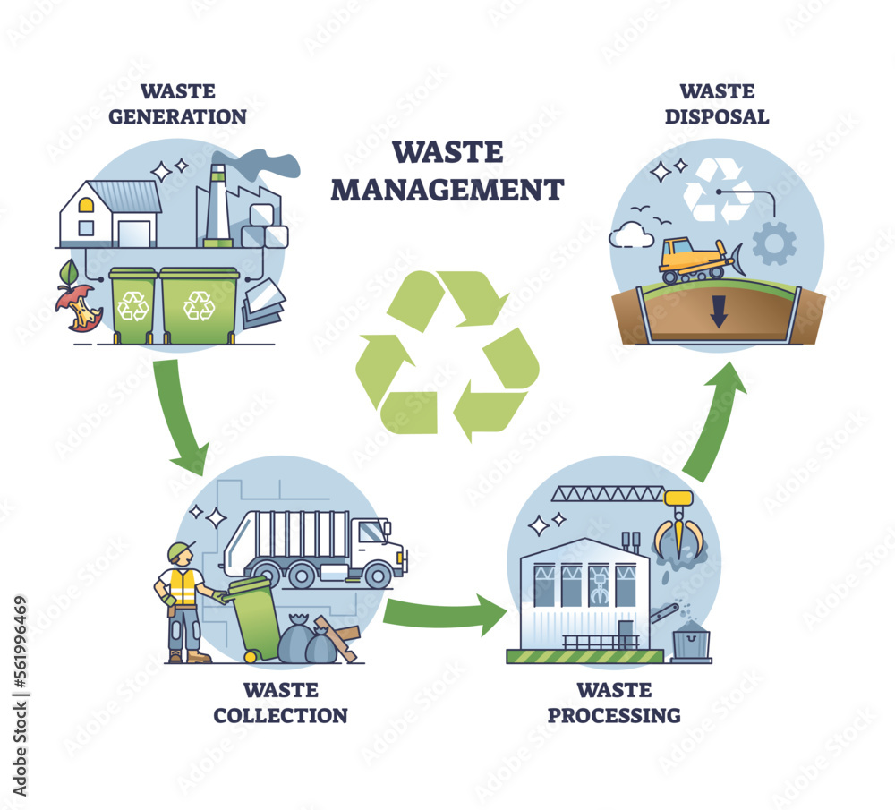

SORTING AND AFFINITY LINK
COLLECTION
USAGE
PROCESS
Paper
Plastic
Glass
Metal
Organic
E-Waste
Mixed
Assembling
Separating
Bio-degradable
Non Bio-degradable
Burrying
Burning
Melting
Pollution control
Fertilizer
Reuse
Clean society
Job oppourtunity
Cleanliness

Slide 7
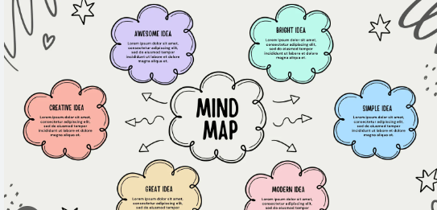
MIND MAPPING

Slide 8
WASTE AUDITS
SYSTEM ANALYTICS
USER EXPERIENCE
ECOSYSTEM INTEGRATE
CIRCULAR ECONOMY
SMART BINS
DESIGN THINKING
DESIGN AND USER EXPERIENCE
SYSTEM INTEGRATION AND IMPACT
TECHNOLOGY AND INNOVATION
SMART SENSORS
SCALABILITY
DATA ANALYTICS
HOUSEHOLD WASTE MANAGEMENT SYSTEM
OPERATIONAL EFFICIENCY
UPCYCLING
WASTE
SEGREGATION
OPERATIONAL AND LOGICAL EFFICIENCY
BEHAVIORAL COMMUNITY ENGAGE
SUSTAINABILITY AND EFFICIENCY
RECYCLING
LIFECYCLE ASSESSMENT
COMPOST
BEHAVIOR CHANGE
PUBLIC AWARENESS
USER ENGAGE
LOCAL SOLUTIONS

Slide 9
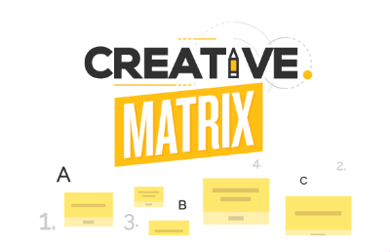
MATRIX TABLE

Slide 10
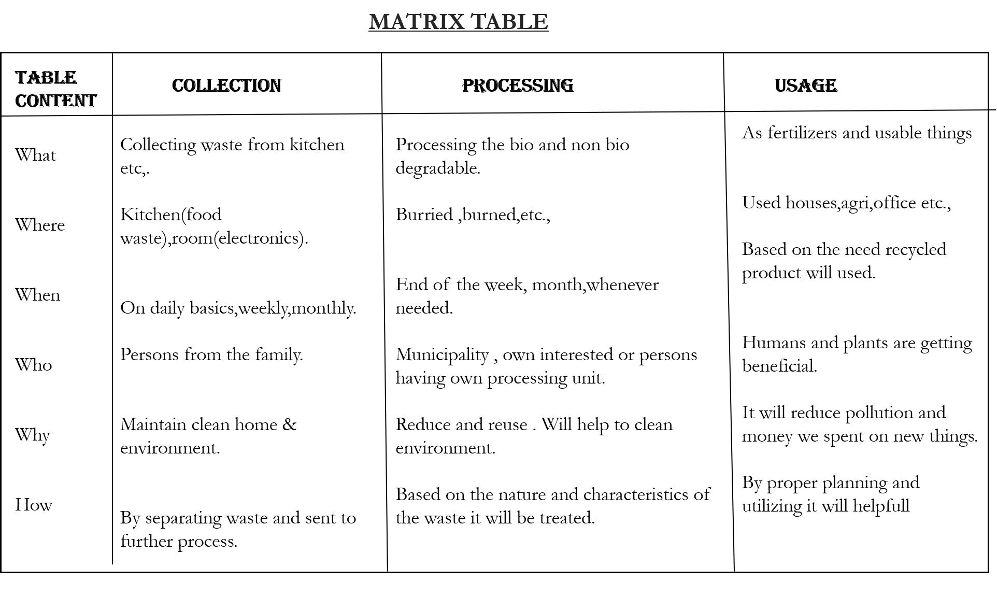

Slide 11
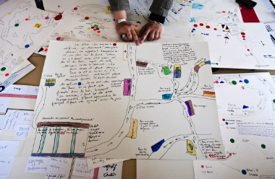
USER PARTICIPANT MAPPING

Slide 12
PRIMARY USER
Individual & residential
Waste collection workers
Sanitation
Recycling
Secondary user
Waste management
Recycling
Composting
landfills
TRITARY USER
Municipal
Government
Non-government
Business
TERTIARY USER
Education
Research
Media
Techno provides stuff

Slide 13
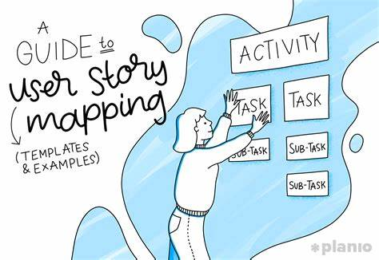

Educate about waste management
processing
Creating app
Government &non government organization
Individuals & residentials
Collection of waste
Municipality collecting waste
Sensor based collection of waste

Slide 14
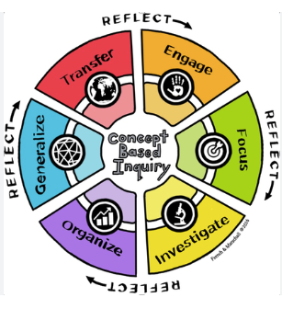
CONCEPTUAL INQUIRY

Slide 15
demographics
Burning
Reuse
Recycle
Burried

Slide 16
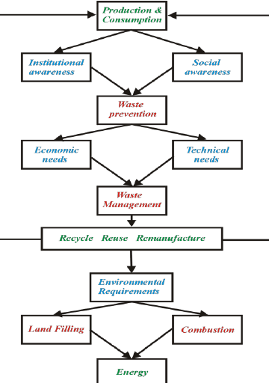
CONCEPTUAL MODEL

Slide 17
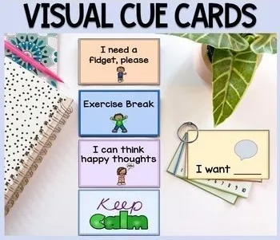
QUESTIONNAIRES AND CUE CARDS

Slide 18
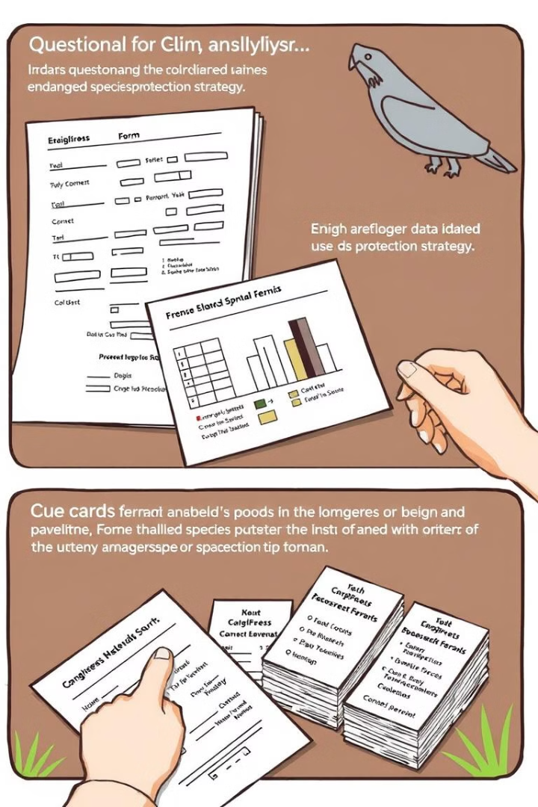



Current Waste Management Practices
How do you currently manage waste in your household?
Separate into recyclables, compost, and trash
All waste goes into one bin
Use a third-party service for waste segregation
Other (please specify)
Challenges and Pain Points
What challenges do you face when managing household waste?
Lack of time
Lack of clear information on recycling
No space for multiple bins
Local authorities don’t provide proper waste collection
Create Cue Cards
Waste Segregation
Reduce, Reuse, Recycle
Composting
Recycling Programs

Slide 19
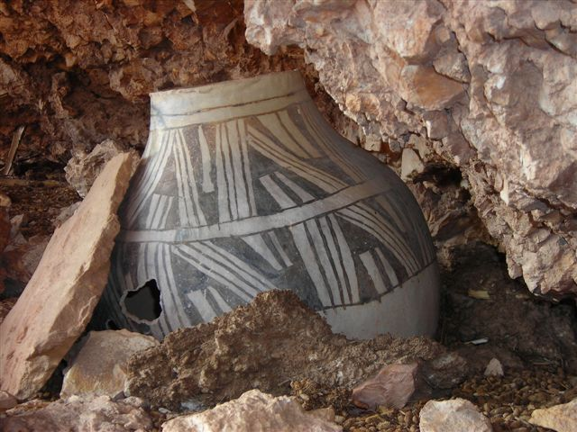
ARTIFACT,ACTIVITY,SPATIAL MAPPING STEPS:

Slide 20
Define Artifacts:
Identify Activities:
Fictional profiles representing different users (e.g., a busy family, eco-conscious individual) to understand their behaviors and pain points.
Conduct interviews and surveys to understand user needs and challenges in waste management.
Synthesize insights to create a clear problem statement (e.g., difficulty in waste segregation).

Slide 21
CONDUCT SPATIAL MAPPING:
ENGAGE STAKEHOLDERS:
MONITOR AND
EVALUATE:
KPIs,Data collection,regular
assessments,impact
analysis,strategy adjustments,and
stakeholders reporting.
Waste generation points,
analyzes layout efficiency, proposes bin rearrangements,
and seeks user feedback for improved waste management.
Through meetings, workshops, surveys, and prototyping sessions to gather feedback, foster collaboration, and ensure project success in waste management.

Slide 22
OIOR TABLE

Slide 23
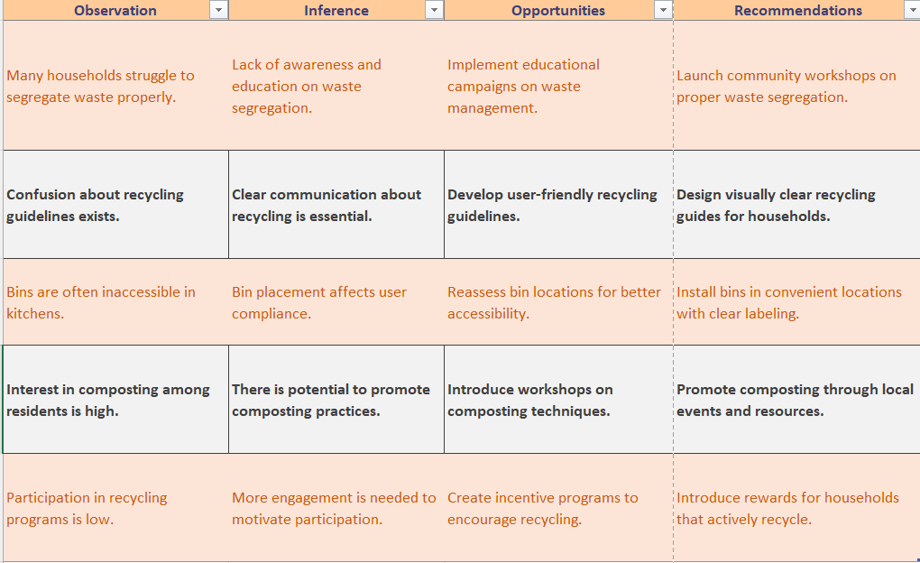

Slide 24
Thank you

